Slide 1
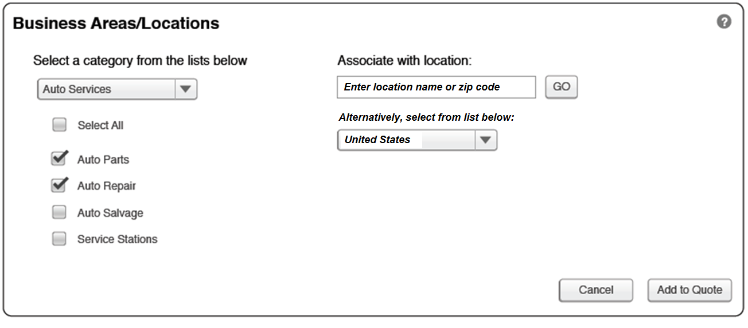
Initial Location Input Screen

Slide 2
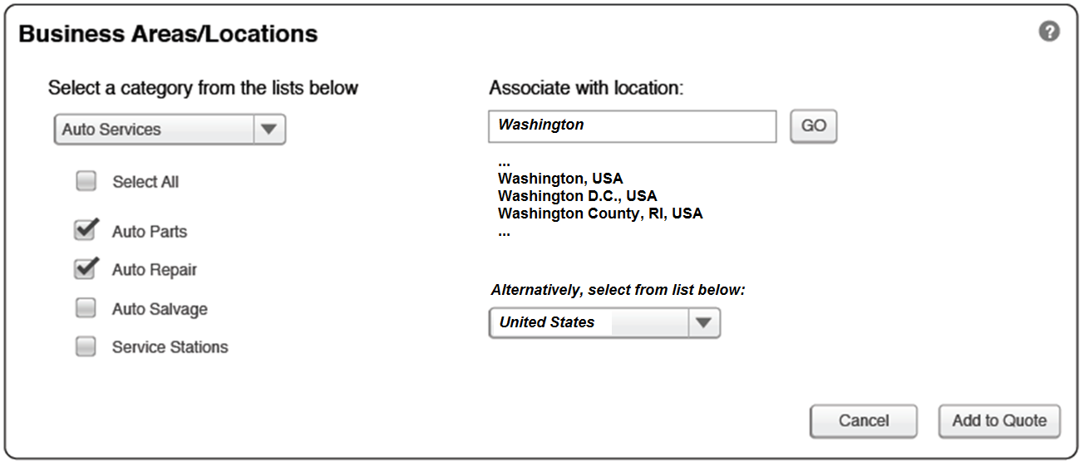
Enter Text to Filter Location List

Slide 3
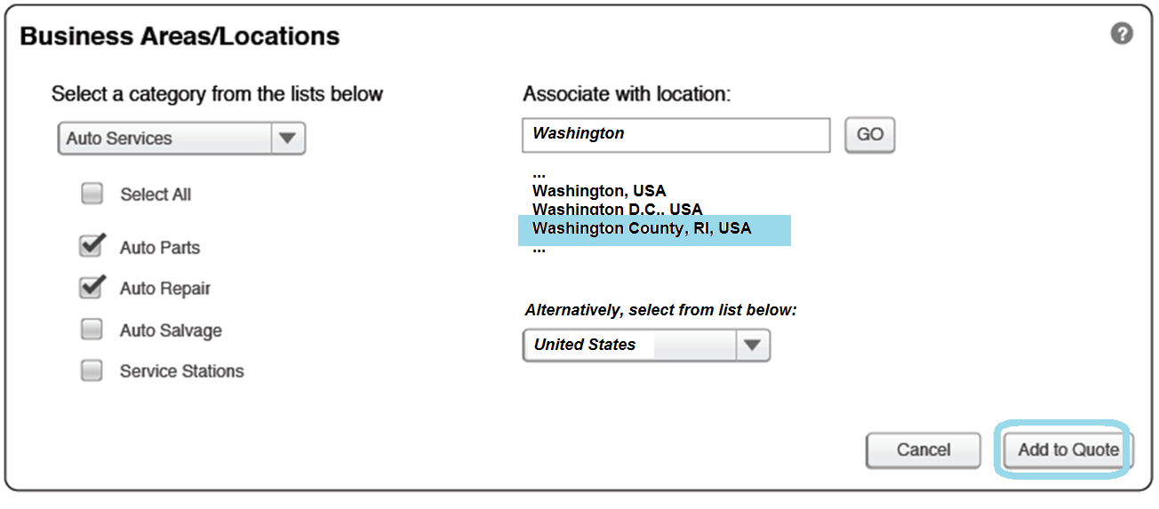
Select Location from Filtered List to Add to Quote
User Can Select Only One Location to Add to Quote at a time! This is to minimize the risk of too many campaigns in the cross product selection. User can come back to this screen and add more locations.

Slide 4
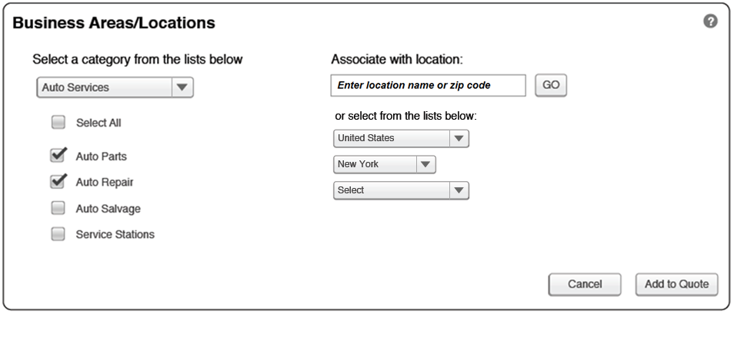
Alternative to Add a Location
User walks through location tree

Slide 5
User Selects Location to Add to Quote
User Can Select Only One Location to Add to Quote at a time!

