Slide 1
AML Permissions

Slide 2
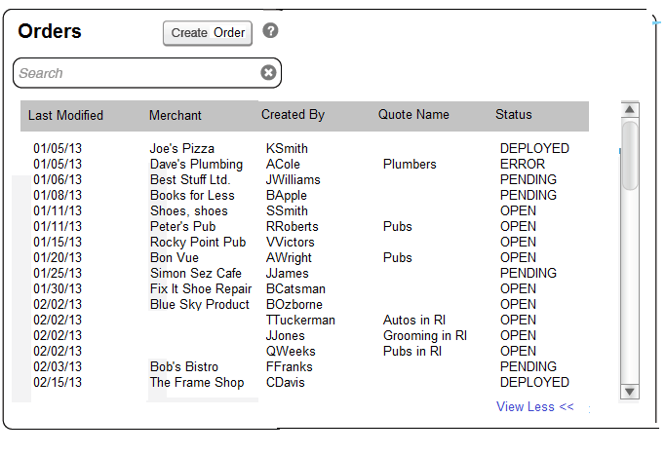
Automate Deployments
Returning Order Status in UI

Slide 3
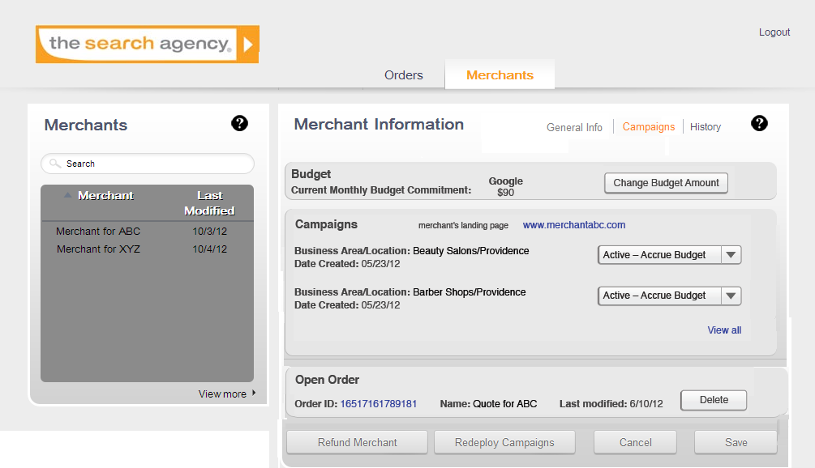
Merchant Campaigns Page

Slide 4
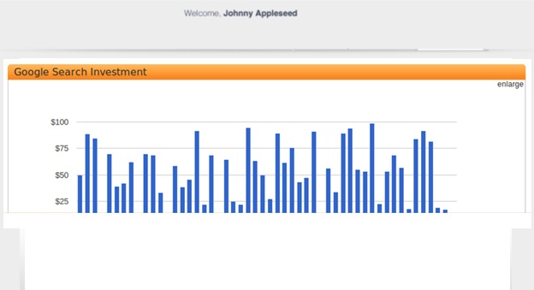
Merchant Spend Reporting
Note that this implies actually creating merchant logins to the merchant UI and sending merchants their login credentials via email.
It probably does not include managing these logins (change password/reset password) ) although we need to add that requirement to the backlog. For now, merchant would call reseller, reseller would open ticket for us. We would update password in database and send it back via email (not very secure or desirable)

Slide 5
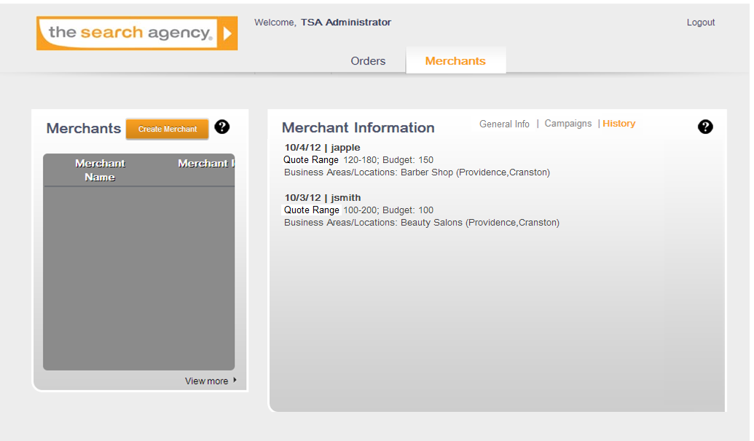
Merchant History Page

Slide 6
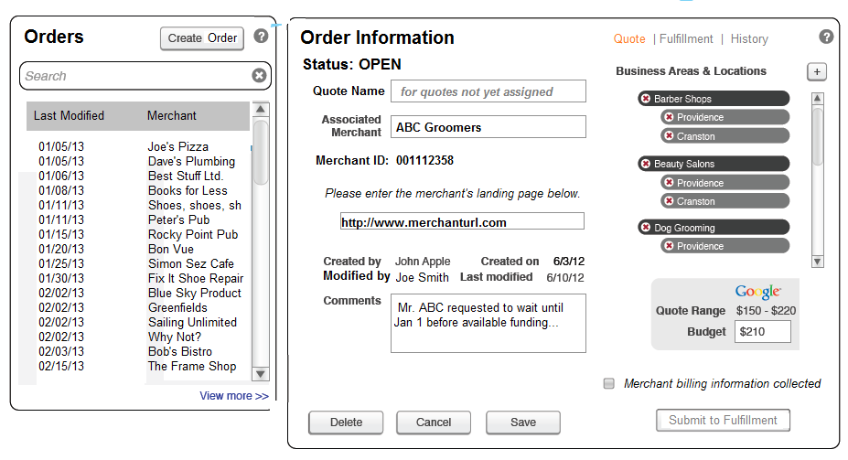
User Roles and Related Permissions
Sales user can view/edit only created Quotes
FF user can only view Quote page for all records
CS user can view/edit Quote page for all records

Slide 7
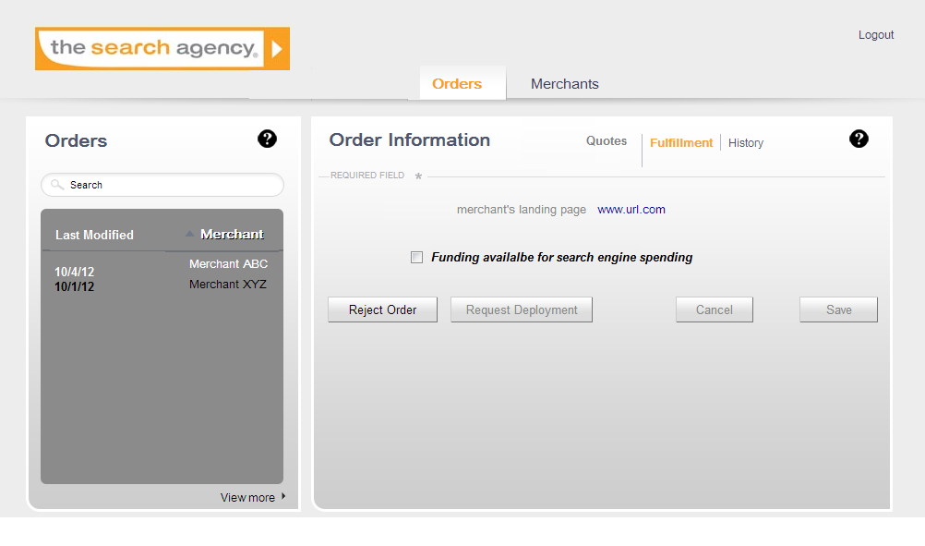
User Roles and Related Permissions
FF user can edit FF page for all records
Sales user can view FF page for created records
CS user can view/edit FF page for all records

Slide 8
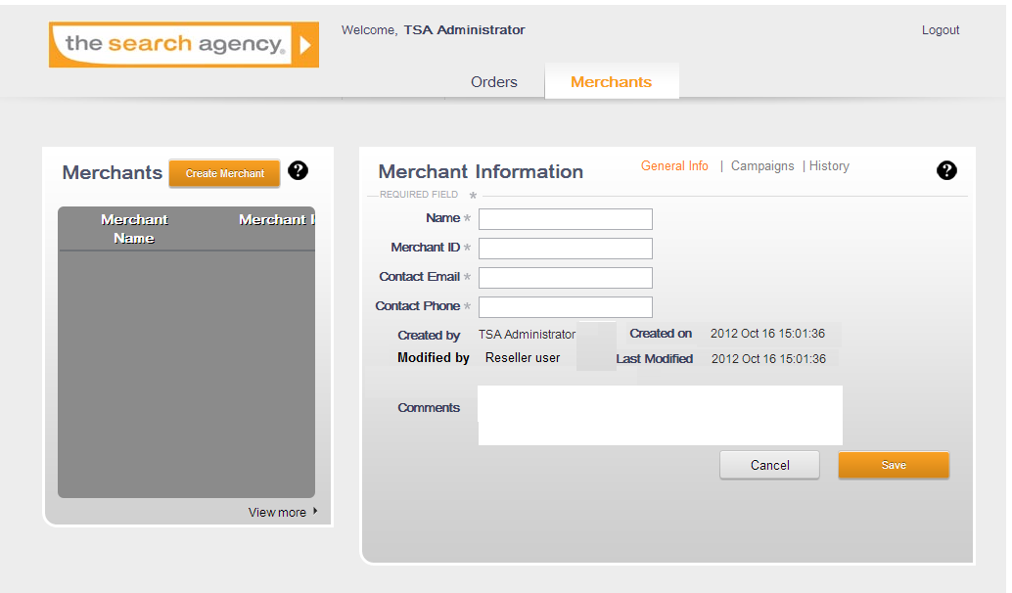
User Roles and Related Permissions
Sales user can view/edit only created merchants
CS user can view/edit all merchants
FF user can view all merchants

Slide 9

Customization of Ads/Keywords

Slide 10
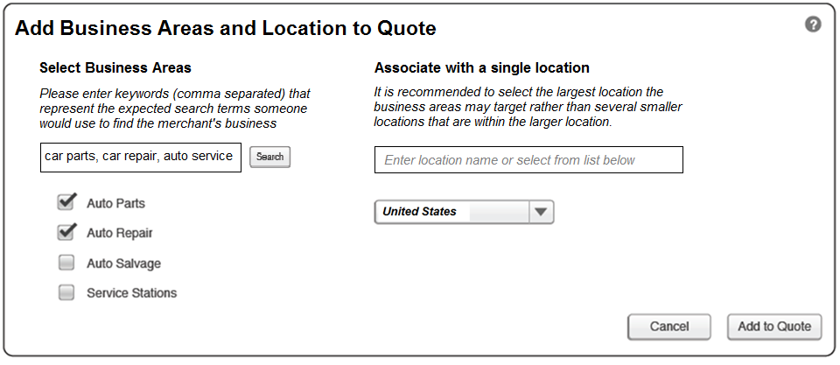
Location Lookup by Search
Initial Screen

Slide 11
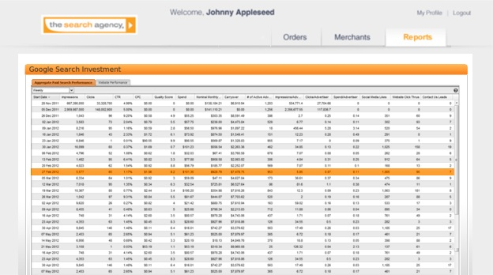
Management Dashboard Reporting

